Slide 1
Topic 11 – Recommender Systems and Ensembles
Data Science and AI For Business – Fall 2025

Slide 2
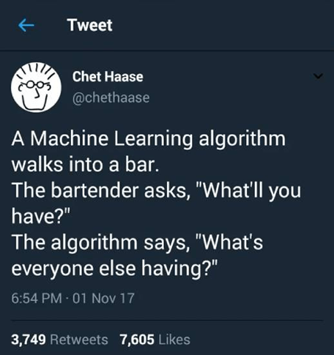
Outline
Recommender systems
Models used
Netflix Prize and its impact
Ensemble Models
Why ensembles win
Boosting, Bagging, Random Forests
XGBoost and GBDT
Shmueli Chapter 9.8, 13
ISL 8.2, 12.3
Notes:
They are everywhere!

Slide 3
Recommender Systems

Slide 4

A good recommendation
Is accurate
Is personalized
Is exploratory
Explore vs. exploit
New discoveries are the largest satisfier
Is diverse
Not the same thing every time (inject randomness?)
Learns from data
Notes:
Talk about why companies do recommendations –
because they surprise and delight
Get you to buy things
Create good word of mouth

Slide 5
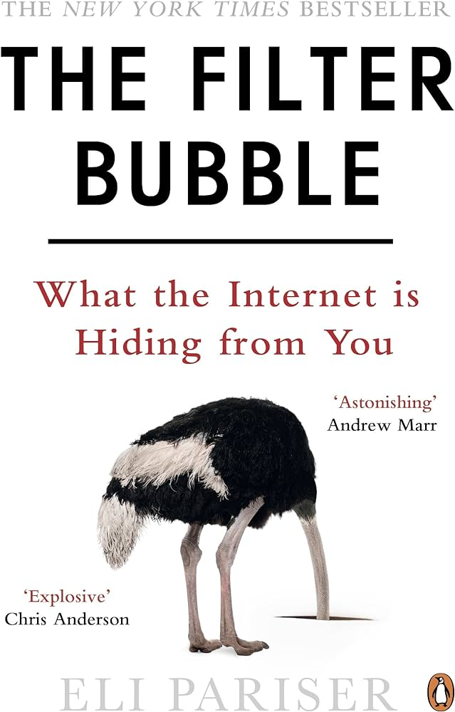
Perils of Recommender Systems
What are the downsides?
Filter Bubbles
Isolates users in an ideological or cultural bubbles
limits exposure to diverse perspectives and experiences
Increased Polarization
Amplifies users' existing beliefs by exposing them to more extreme views (“clickbait”)
Data Privacy Concerns
Collection and analysis of personal data for tailoring recommendations raise significant privacy issues. (e.g. searches for “depression”)
Discussion: how do these concerns align with business goals?
Notes:
Search – if you search for something like “immigration policy” it will use previous info to bias what results you get.
What is the business angle here? Arent you just better off givng the customer what they want?
Strategic Business Goals vs. Filter Bubbles
Customer Engagement and Satisfaction:
Short-term: Initially, recommender systems that create filter bubbles may increase user engagement and satisfaction by presenting highly personalized content. This can drive immediate metrics such as time on site, repeat visits, or sales conversions.
Long-term: Over time, however, users might experience a decrease in content diversity, leading to dissatisfaction, reduced engagement, and potential loss of trust in the brand as they seek more varied content elsewhere.
Brand Perception and Market Reach:
Niche Marketing: Tailored content can strengthen brand loyalty among existing customers by catering precisely to their preferences.
Market Expansion: Conversely, avoiding filter bubbles can help businesses reach new audiences and market segments, preventing them from being pigeonholed into serving a narrow customer base.
Innovation and Growth:
Recommender systems focused narrowly on user past behavior may stifle discovery and innovation, both for users and the business. Encouraging exposure to a broader range of products or content can spur innovation, as it allows businesses to test and refine new offerings based on a wider array of user interactions and feedback.
Ethical Considerations and Corporate Responsibility:
There's a growing demand for ethical considerations in business practices, including how data and AI are used. Companies that proactively address the downsides of technologies like recommender systems can enhance their corporate responsibility profile, appealing to consumers and investors who value ethical considerations.
Economic Implications:
From an economic perspective, filter bubbles can lead to market fragmentation, where users become isolated within echo chambers. This can limit the overall market potential and reduce the effectiveness of broad-based marketing strategies.
Are Firm's Goals Met by Avoiding Filter Bubbles?
The alignment of a firm's goals with the strategy to avoid filter bubbles largely depends on the firm's long-term vision and values. If a company prioritizes sustainable growth, market expansion, innovation, and ethical practices, then developing strategies to mitigate the effects of filter bubbles could align well with its objectives. For instance:
Diversifying User Experience: By introducing users to a broader range of products or content, firms can foster a more diverse and engaging user experience, potentially increasing user retention and attracting a wider audience.
Building Trust and Transparency: Companies that address the downsides of personalization openly can build trust with their customers, showing commitment to more than just short-term engagement metrics.
Fostering a Healthy Information Ecosystem: For platforms that rely on content consumption, avoiding filter bubbles can contribute to a healthier public discourse, which can be particularly important for brand reputation in the long term.
In summary, while the immediate efficiency metrics of recommender systems may seem attractive, business students should consider the broader implications of these systems on market dynamics, consumer behavior, and societal impact. Balancing personalization with the need to avoid filter bubbles can help businesses achieve more sustainable and ethical growth.

Slide 6
Models for Recommender Systems

Slide 7
Models for Recommender Systems
What makes RecSys different than just a regular classification problem?
Multiclass problem with many classes
Goal is a ranking, not a prediction
Long tail of content
Three main models that are used, with many variants
Content-based
Similarities (modified kNN)
Matrix Factorization
Collaborative filtering: modelling you based on preferences of similar users
Notes:
Training data is not a bunch of observations with a label…it is many observations with many labels…

Slide 8

RecSys 1: Content-based
Fit models based on a massive set of engineered features
 | Gwenda
Actor: John Travolta | 1
Actor: Uma Thurman | 1
Actor: Samuel L. Jackson | 1
Actor: Bruce Willis | 1
Genre: Crime | 1
Genre: Action | 1
Genre: Suspense | 1
Director: Quentin Tarantino | 1
Era: 1990s | 1
Style: Noir | 1
Writer: Roger Avary | 1
… | …
Gwenda watches:

Slide 9


RecSys 1: Content-based
Pros:
Very clear why a given recommendation was made
Cons:
Many arbitrary decision need to be made
Which actors, directors, etc
What are genres, subgenres
Many thousands of parameters
Needs regularlization
Does watching Pulp Fiction really mean you want to watch all Travolta movies?

Slide 10
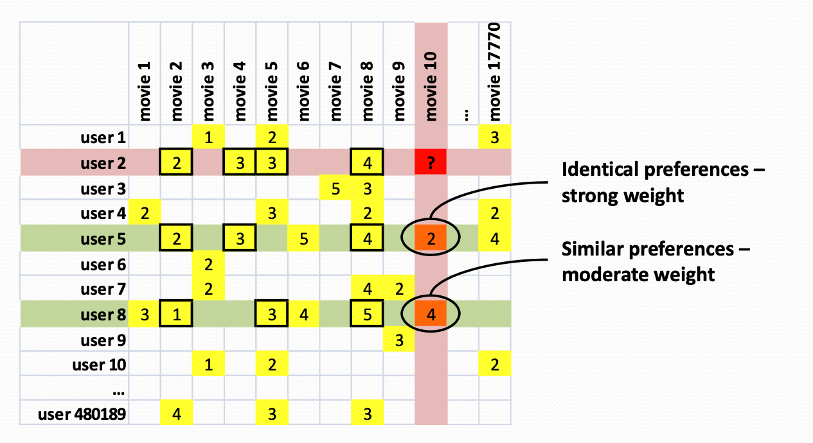
RecSys 2: k-Nearest Neighbors
users
Image from Jeff Howbert, UW

Slide 11
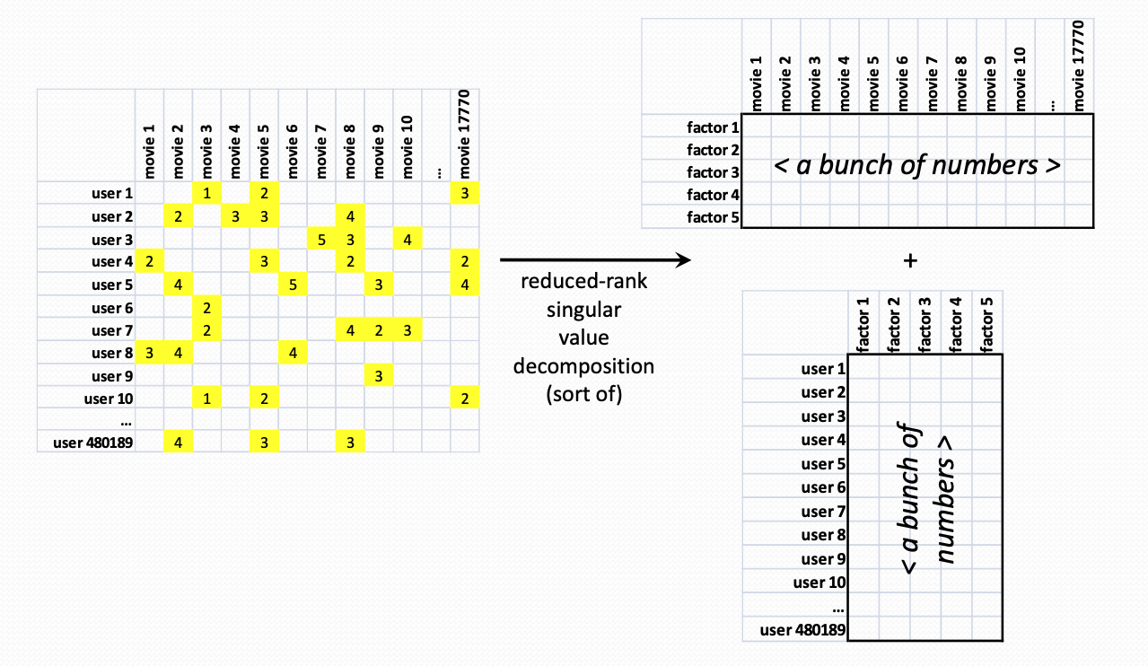
RecSys 3 – Matrix Decomposition
Any matrix can be decomposed into smaller elements
Similar to principal components: r determines how much compression
The ratings matrix is decomposed into smaller pieces – one for the users and one for the content
Why is this relevant….
Image from Jeff Howbert, UW
Notes:
Additionally
10000 x 1000 = 10 000 000
10000 x 10 + 10 x 10 + 1000 x 10 = 100k + 100 + 10k = 110k

Slide 12
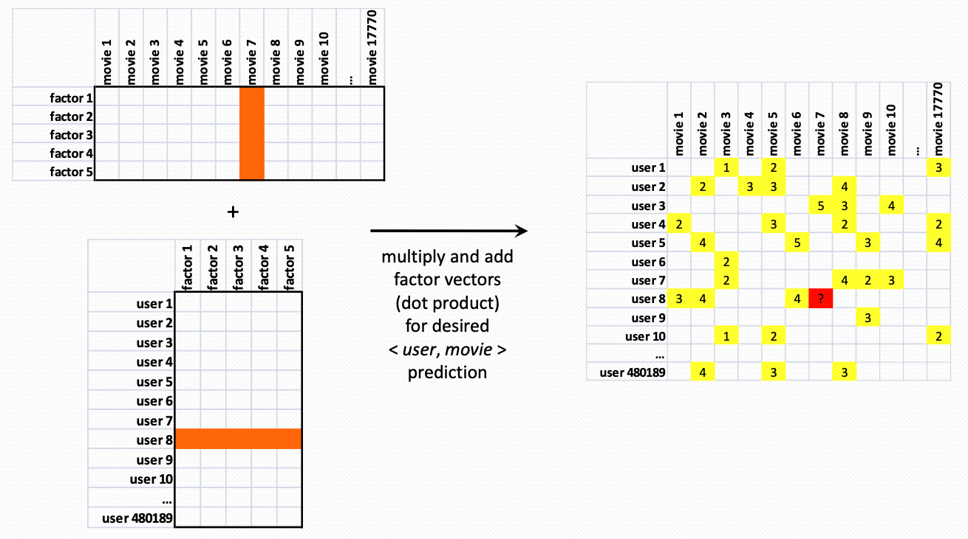
RecSys 3: Matrix Decomposition - SVD
Example with 3 latent factors (concepts)
~
Multiplying the component matrices together reconstructs the original matrix, and fills in the holes (aka predictions!)
The users and the content are now described by latent factors – hidden traits that describe the characteristics of movies
See ISL 12.3
Image from Jeff Howbert, UW
Notes:
latent factors — which are hidden traits that explain preferences.
they’re discovered automatically from the data. That’s why they’re called latent.
For instance, it might discover…
The approximation that does the best job of reconstructing what is there
As a by-product, it fills in the missing values!!

Slide 13







Matrix Decomposition : Latent Factors
serious
Braveheart
The Color Purple
Amadeus
Sense and Sensibility
Lethal Weapon
Geared towards females
Ocean’s 11
Geared towards males
The Lion King
Independence Day
The Princess Diaries
Dumb and Dumber
escapist
Notes:
SVD reduces the data into dimensions that describe the data.
This is all just automatically revealed by the algorithm…it identifies the features that separate peoples tasts.

Slide 14
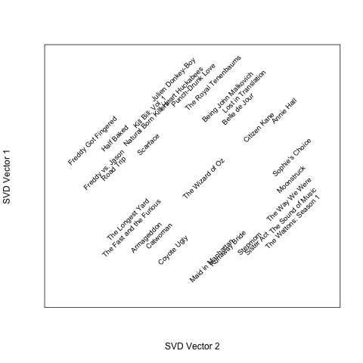
Netflix Data – first two latent factors

Slide 15
Summary - RecSys
Recommender System Models
1. Content based
Uses info on the movie, doesn’t require any ratings
2. Similarity based
Uses “collective” info on what others like, similarities between users and content
kNN
3. Matrix Decomposition based
Find interesting dimensions of the data that define how people differ on movie ratings
How might you evaluate a recommender system?
Notes:
Evaluation could be based on click, on buy, on rating….
Would they have watched without a recommendation at all?
What if you only recommend the most popular things?
What if they watched it, but would have watched it anyway?
Best feedback is a survey,, but those arehared.

Slide 16
Netflix Prize

Slide 17
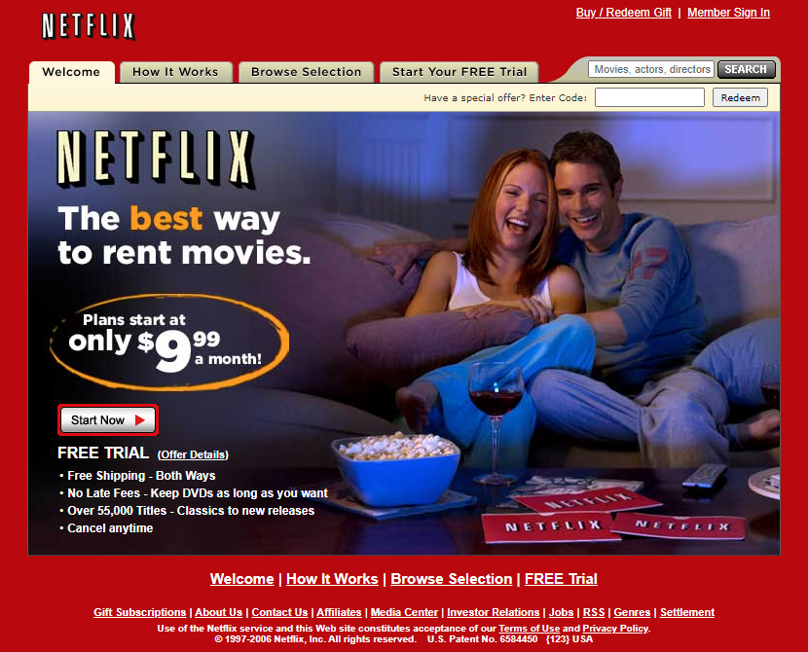
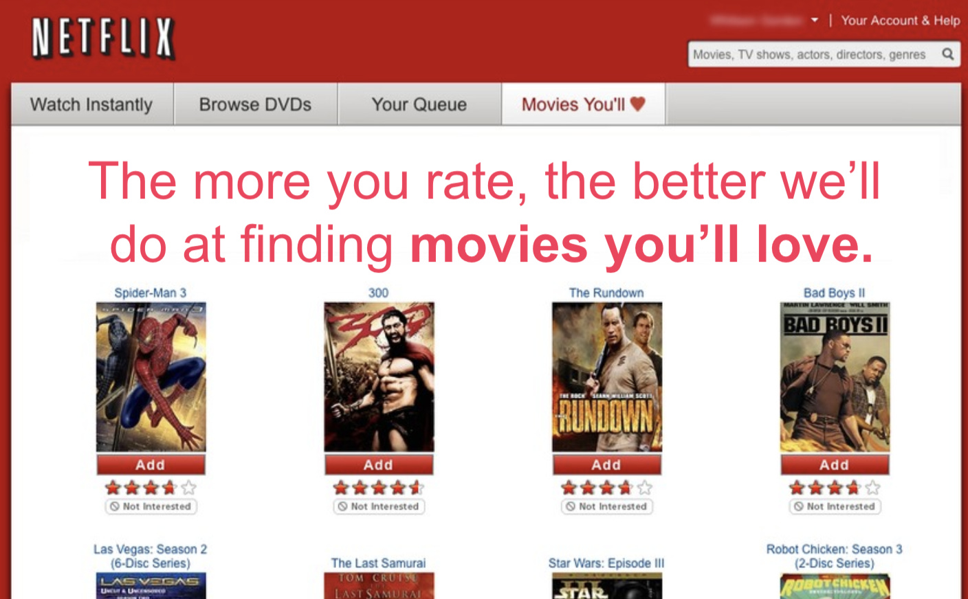
Netflix in 2006
Cinematch: predict star rating for every movie for every customer

Slide 18
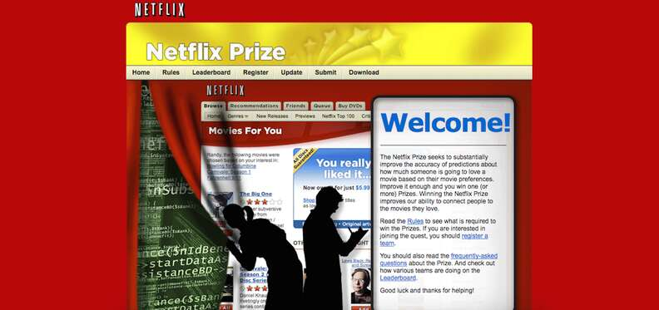
Netflix Prize – October 2006
Goal:
Can a team improve on Cinematch error rate?
October 2006: Offers $1,000,000 if someone can beat Cinematch RMSE by 10%
If 10% not reached, $500k (Progress Prize) given to team in the lead each year
Conditions:
Open to the public
Teams could submit once per day
Winning teams had to publish algorithm and provide a non-exclusive license to Netflix

Slide 19

Data scientists were excited…
41k teams downloaded the data
186 countries
5169 teams submitted a solution

Slide 20
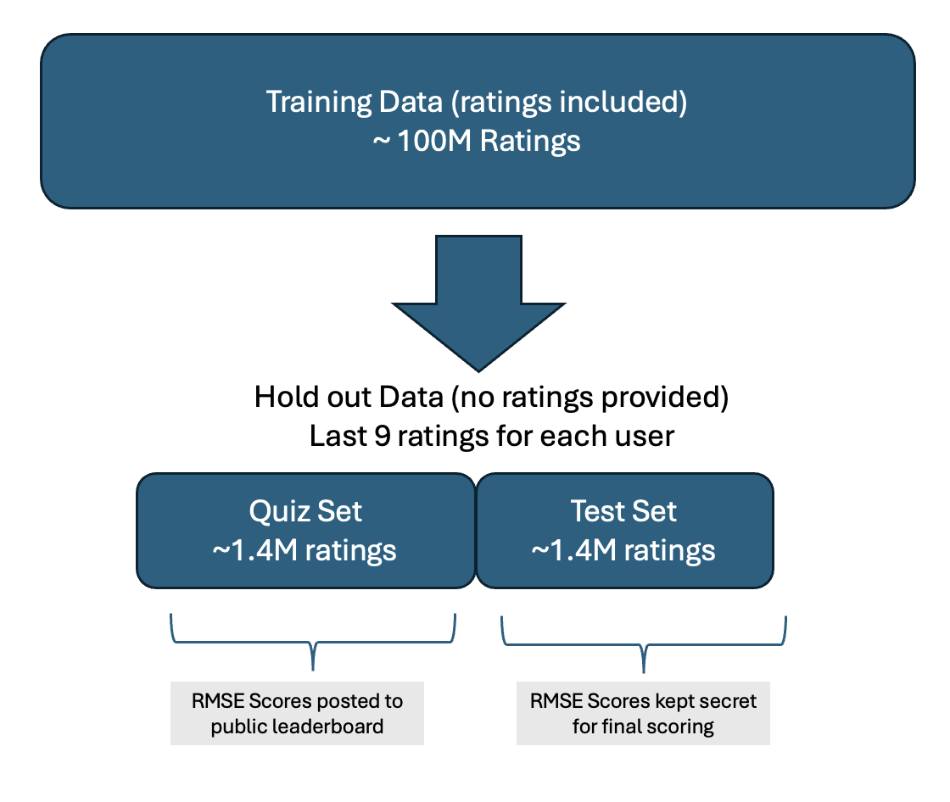
Competition Details
480k unique users
6 years of data
date | score | movie | user
2002-01-03 | 1 | 21 | 1
2002-04-04 | 5 | 213 | 1
2002-05-05 | 4 | 345 | 2
2002-05-05 | 4 | 123 | 2
2003-05-03 | 3 | 768 | 2
2003-10-10 | 5 | 76 | 3
2004-10-11 | 4 | 45 | 4
2004-10-11 | 1 | 568 | 5
2004-10-11 | 2 | 342 | 5
2004-12-12 | 2 | 234 | 5
2005-01-02 | 5 | 76 | 6
2005-01-31 | 4 | 56 | 6
… | … | … | ….
102M rows
17,700 unique movies
Movie | Title
1 | Dinosaur Planet
2 | Midnight Run
… | …
Notes:
What are the features? What is the target?
Build a model for each movie.
Want to predict if someone will like Jurassic Park
Need a matrix – training data of all the people who watched Jurassic Park
Target is rating of JP
What are the features?
What is the average number of movies rated per user?
What is the average number of users that rate a movie?
Want to create features for the users, how can we do that? Create 10 for users and 10 for movies…
Max rating user”. 17659 (is that real?) average is just over 200…
Max number of ratings movie? 240k – Miss Congeniality.
Number of movies rated
Average of movies rated
Max score
Min score
Average score
SD score
How did they rate similar movies to Jurassic park how did they rate movies with same director (if any)
% of ratings that are 5
Day span of ratings
Max ratings on a single day
Most recent rating (how many days ago)
Summer/winter?
How many other movies were rated on this day?
DATE ISNT USEFUL!
Movies
How many people rated it?
What is the span of time?
Genre
Sub-genre
director

Slide 21
Data Characteristics

Slide 22
Data Characteristics
Count | Avg rating | Most Loved Movies
137812 | 4.593 | The Shawshank Redemption
133597 | 4.545 | Lord of the Rings: The Return of the King
180883 | 4.306 | The Green Mile
150676 | 4.460 | Lord of the Rings: The Two Towers
139050 | 4.415 | Finding Nemo
117456 | 4.504 | Raiders of the Lost Ark
Most Loved Movies
Most Rated Movies
Miss Congeniality
Independence Day
The Patriot
The Day After Tomorrow
Pretty Woman
Pirates of the Caribbean
Highest Variance
The Royal Tenenbaums
Lost In Translation
Pearl Harbor
Miss Congeniality
Napolean Dynamite
Fahrenheit 9/11

Slide 23
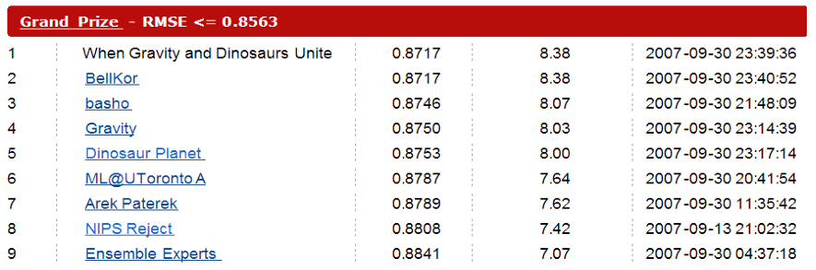
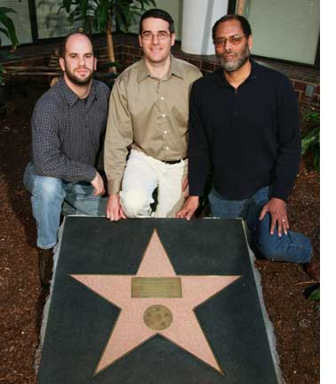
Netflix Prize : the first year
We slowly moved up the charts, and were in position to win the first year prize of $50k…
But then….24 hours to go…
We ended up winning the first year prize, but we had no idea at the time how this move would change the competition (and really all of machine learning)

Slide 24

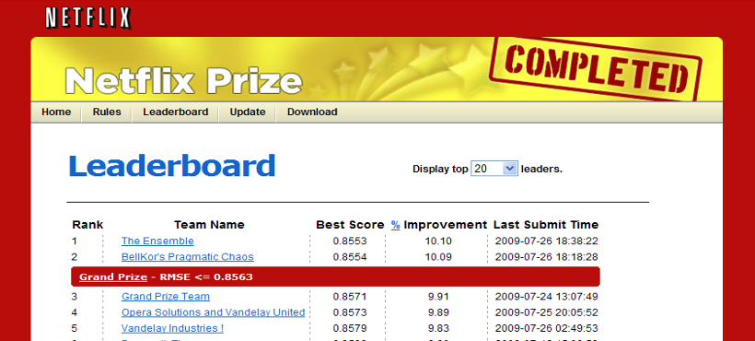
So The Drama
Timeline:
2008: BellKor merges with BigChaos to win 2nd $50K Progress Prize (9.4%)
2009: BellKor, Big Chaos and Pragmatic Theory merge and passing 10% threshold
This begins 30 day ‘last call’ period.
July 25, 2009 (25 hours left):
We crawl up to 10.08%...
The Ensemble, a coalition of 23 independent teams, combine to pass us on the public leaderboard
😱

Slide 25
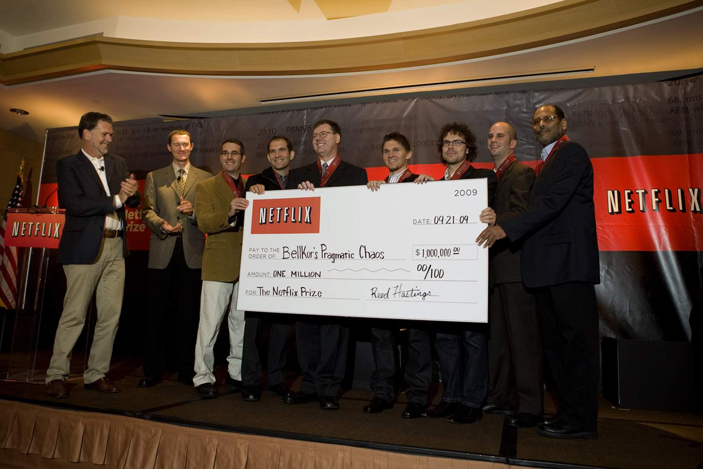
Test Set Results
BellKor’s Pragmatic Theory: 0.8567
The Ensemble: 0.8567
Tie breaker was submission date/time
We submitted 20 minutes earlier 🏆
Note: a combination of BPC (10.06%) and Ensemble (10.06%) scores results in a 10.19% improvement
ensembles of ensembles of ensembles…
Notes:
🏆

Slide 26
Our Approach
Our Prize winning solutions were an ensemble of many separate solution sets
Progress Prize 2007: 103 models
Progress Prize 2008 (w/Big Chaos): 205 models
Grand Prize 2009 (w/ BC and Pragmatic Theory): > 800 models!!
We used all of the models we knew of – thrown together:
Nearest Neighbors
Matrix Decomposition
Regularized regression (aggressive regularization!)
etc etc
Interesting note: Content models added zero value
Ensembles of ensembles of ensembles!

Slide 27


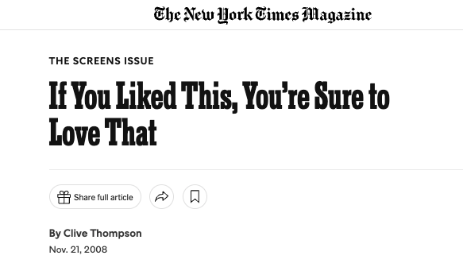

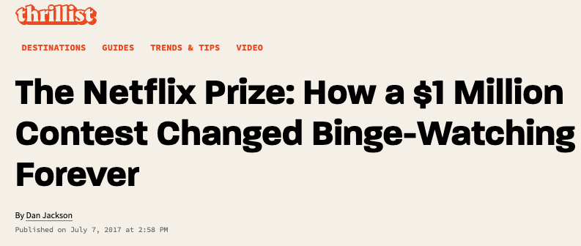
Legacy of Netflix Prize
The power of friendly competition
Cross team ideation, sharing, collaboration
The power of ”open science”
Netflix took a real risk to open data to public
Crowdsourcing wins: Kaggle was born
The power of ensembles!
Inflection point in data science

Slide 28
Ensemble Methods

Slide 29
Ensemble Methods
Concept: a combination of models can perform better than any single model itself.
Logistic Regression
Decision Tree
Neural Net
1
0
1
Ensemble Prediction = 1
Linear Regression
Regression Tree
Neural Net
22
10
28
Ensemble Prediction =20

Slide 30
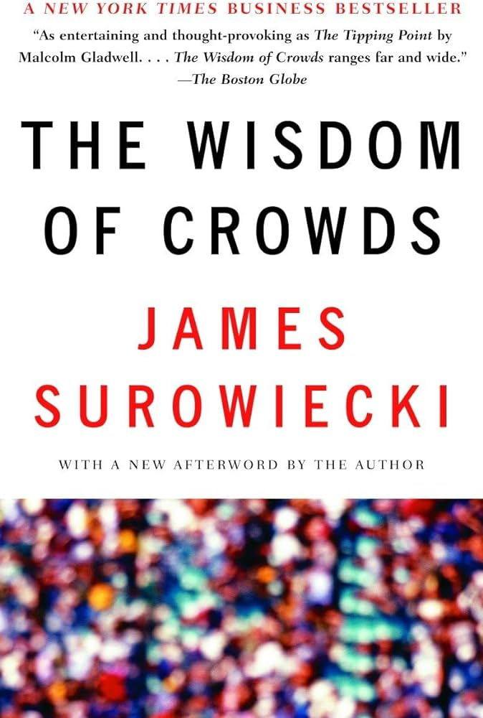
Ensembles: Motivation
Models are simple, but reality is complex
The “truth” is often more complicated than any one model can capture
Combinations of “simple” models can capture arbitrarily complex systems
Example : spam rule based systems, neural nets: many different rules, each simple, combined can work well
An average of several predictions can be more accurate and stable than a single model
Accuracy: how well it predicts
Stable: how impacted the model is by outliers or single points
The Wisdom of Crowds
Predictions based on a collection of independent opinions will perform better than any single expert
Notes:
Maybe introduce the bias / variance tradeoff.

Slide 31
Ensembles: How they work
The ensemble predicts a target value using an average of predictions of several individual models
Each model is fit independently of the others
For a continuous target, an ensemble averages predictions
May be weighted
For a categorical target (classification), an ensemble will use “voting” of the predictions of individual models
The Netflix Prize winning solution was a weighted average of 800+ individual models!

Slide 32
Ensembles: why they work
Wisdom of Crowds: “Ensembles work best when the models are independent, decentralized, and have diversity of opinion”
For real world examples, this means embrace diversity (in all forms)
For data science models: this means, maybe they are built on different data sets, or use different features.
is this a sensible assumption?
Even though models are not typically independent, they are capturing different elements of of the signal, and still work very well!
Netflix Prize took advantage of this:
Different models from the same team
Different teams approach the problem differently, maybe engineer different features
Notes:
Work very

Slide 33
Ensembles
T10_Ensembles.ipynb

Slide 34
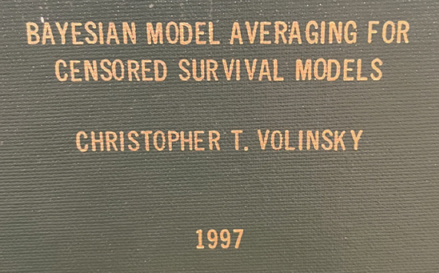

Ensembles: use in data science
In the 1990s, the theory resulted in the creation of many methods to exploit the theory of ensembles:
Boosting
Random Forests
Other methods with fun names:
Arcing
Bagging
Bumping
Crumpling
Born-again models
Bayesian Model Averaging
Close to my heart <3!

Slide 35
Ensemble Methods: Boosting
Boosting takes advantage of a key theoretical finding in ensembles: “Theory of Weak Learners ”
Says that if you want to build the best ensemble, you should build it from models that aren’t that good themselves!!
A Weak Learner is a model that is only slightly better than random chance
The Theory of Weak Learners says that combining many weak learners, as long as they have some independent information will perform better than combining strong learners.
🤯

Slide 36
Boosting: How it works
Boosting steps:
Fit a simple classifier (weak learner) to the data set
Identify the cases the classifier got wrong
“upweight” or “upsample” the mis-classified cases
Fit classifier again
Rinse and repeat
Stop after k iterations, the final prediction is an ensemble of all of the component models (perhaps weighted)
Simple classifier could be as simple as a one-split tree!
Boosted stumps
Notes:
Gradient – Gradient Descent…it is how the model is fit
Boosted – Boosting! Using many many trees, as weak learners.
Decision Trees – we know what these are, but we are mostly using stumps

Slide 37
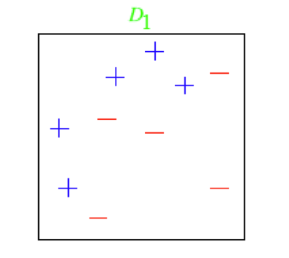
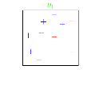
Boosting Example
Courtesy M. Littman

Slide 38
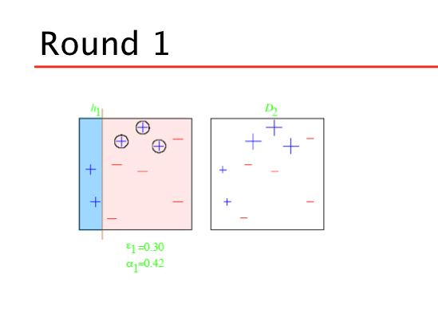
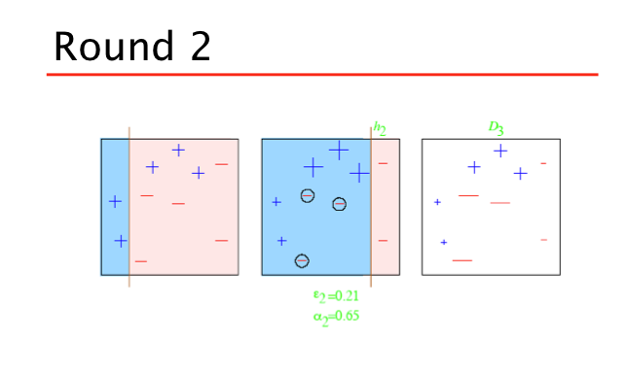
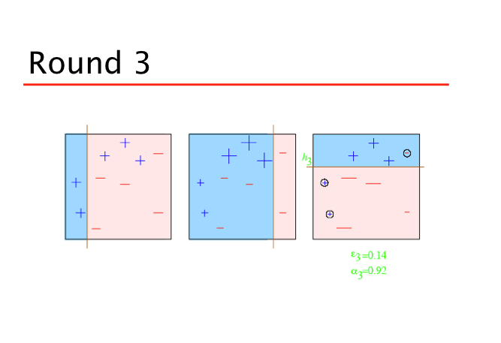
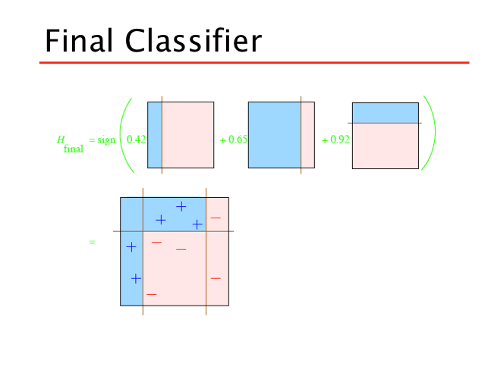
Boosting Example
Courtesy: M. Littman

Slide 39
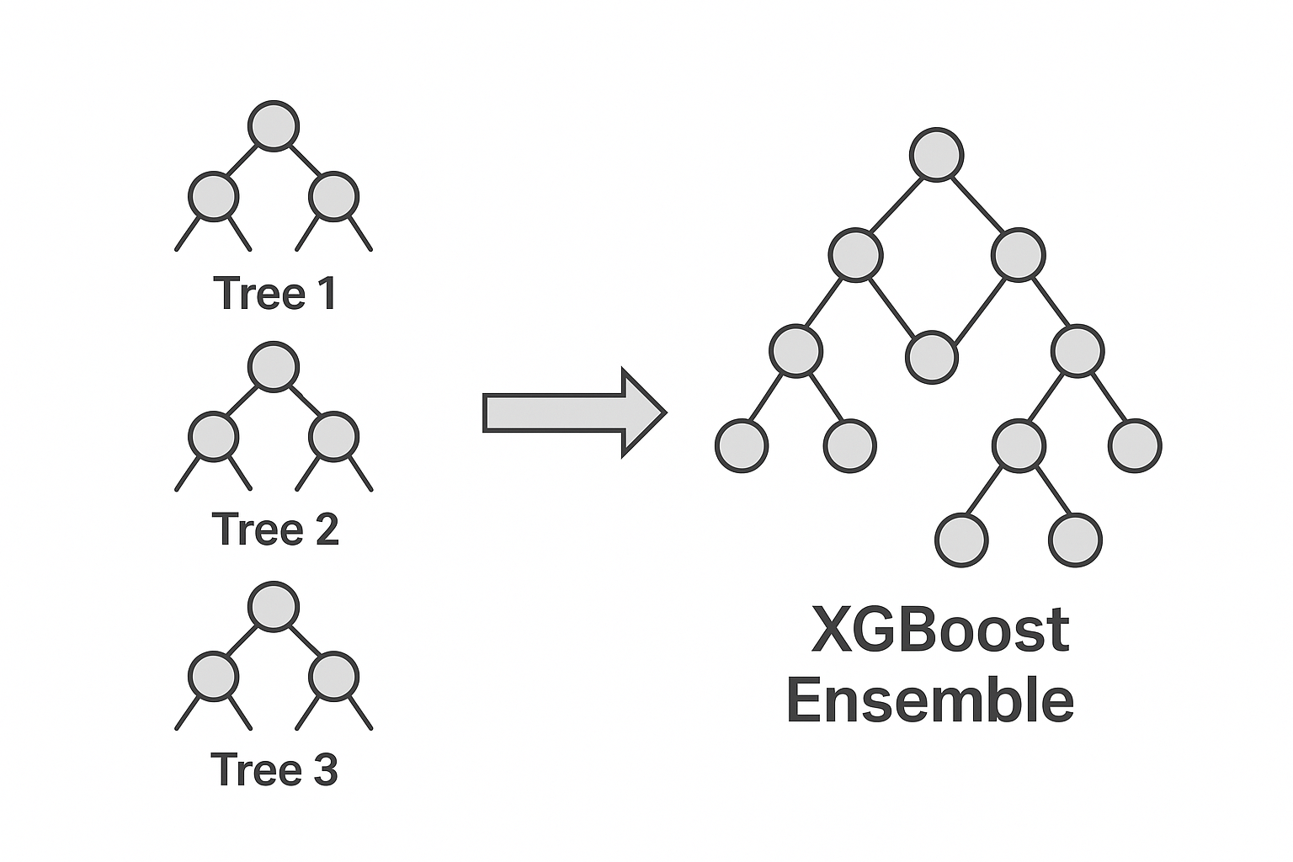
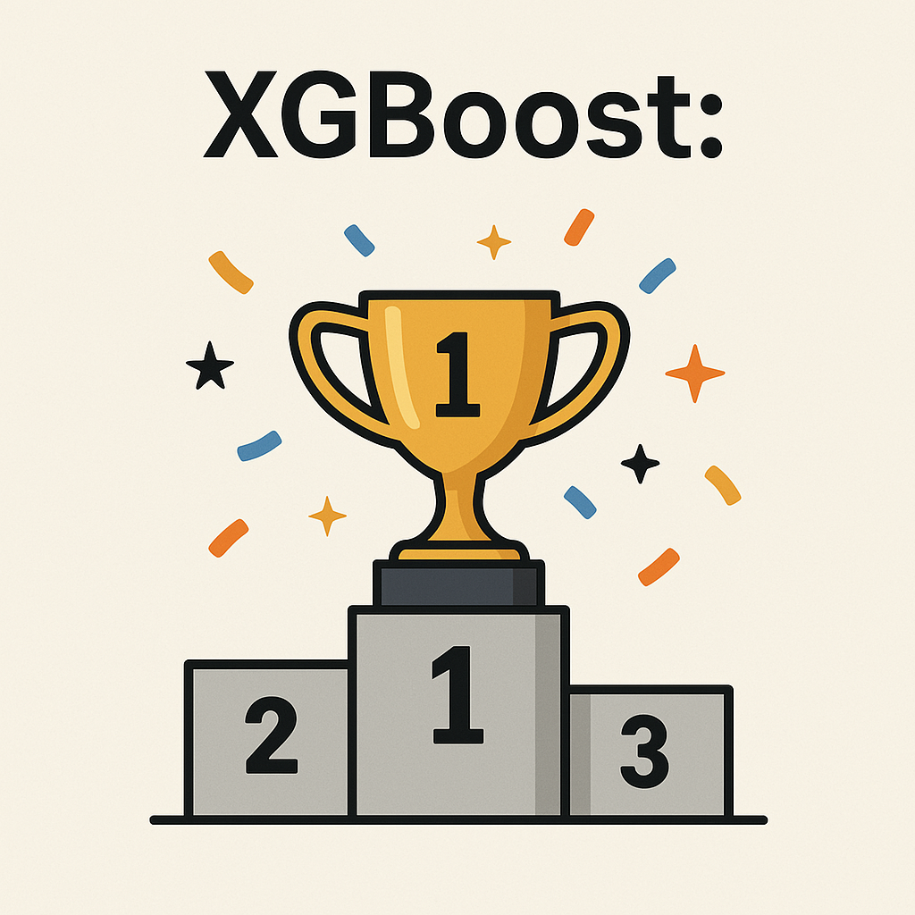
Gradient Boosted Trees: XGBoost
An ensemble of small decision trees, where each tree learns from the mistakes of the previous ones
Fast & Efficient - Parallel computation for large datasets
Handles missing data intelligently - Learns optimal handling for missing values
Flexible & Customizable - Supports many problem types (regression, classification, ranking)
Proven Track Record - Dominates Kaggle competitions - Used extensively in industry (fraud detection, marketing, recommendations)
import xgboost as xxgb
xgb.XGBClassifier()
Notes:
Some of the absolute best predictive models are based on Boosting!
Adaboost
Gradient-boosted decision trees (GBDT)**
XGBoost

Slide 40
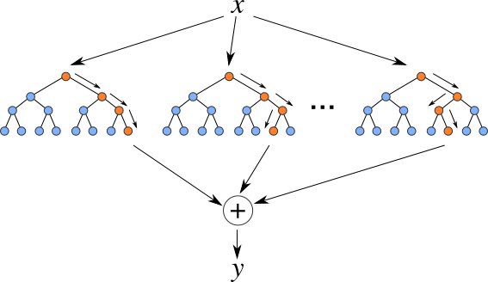
Random Forests:
Solves a problem with decision trees
Very dependent on the first split
Idea - Build many decision trees and average them
Better if the trees are weak: use small trees or even stumps
Even better idea to inject “diversity” -- at each step:
Use a random sample of your data
Use a random sample of predictors
Reduces correlation between models, improving the ensemble
The resulting models don’t have to be great, they just have to be at least “weak”!
Final prediction is the average across all the trees :

Slide 41
Random Forests vs Trees
Random Forests:
Tend to predict better
In fact RF are some of the best performing models out there
More robust to outliers
Smoother decision surface
BUT
Don’t have the nice interpretation of trees
Although RF classifiers do output feature_importances_
Can be computationally intensive
Have many parameters to optimize
sklearn.RandomForestClassifier
Some good code examples in Shmueli 9.8 (RF) and 13.1 (Boosting)

